Slide 1
Week 11 – AP Macroeconomics

Slide 2
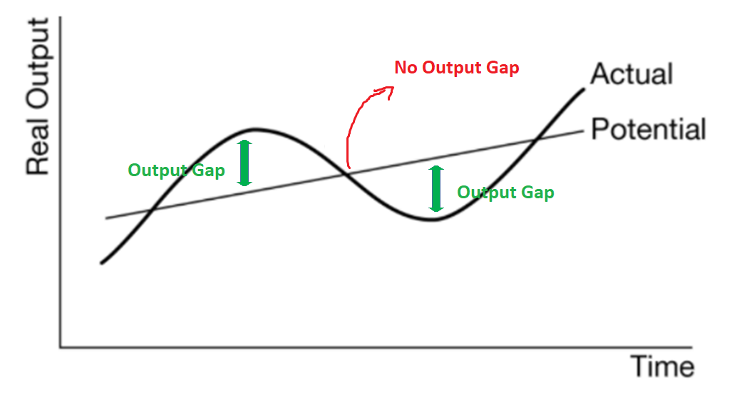
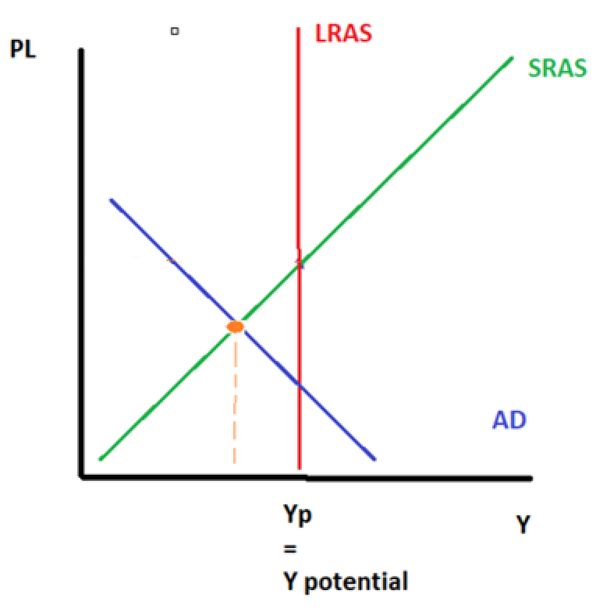
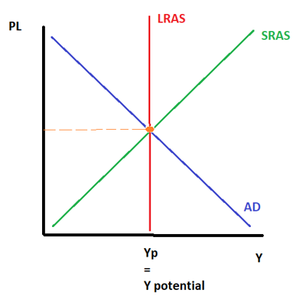
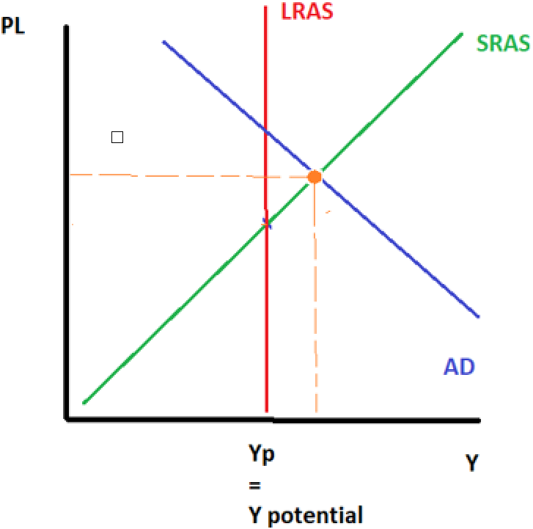
AD/AS Output Gaps
Output gap = Actual Aggregate Output (Y_{Actual}) – Potential Output (Y_{Potential})
An output gap, is any situation where the economy is producing less or more than the long run equilibrium: potential output, Yp.
There are three conditions that the economy can be in at any given time.
  Long Run Equilibrium – producing at Y_{P}
  Negative Output Gap – producing below Y_{P}
  Positive Output Gap – producing above Y_{P}
Negative Output Gap
Long Run Equilibrium
Positive Output Gap
Note: The following all have the same Meaning:
  Y_{p}
  Potential Output
  NRU Output
  Full Employment Output
Y_{actual}
Y_{actual}

Slide 3
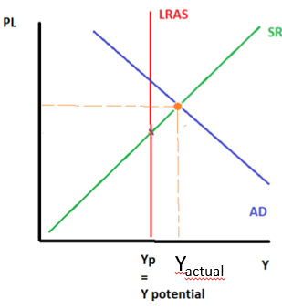
Draw three AD/AS equilibrium on three separate graphs.
Negative Output Gap, Potential Output, Positive Output Gap
Y_{actual}

Slide 4
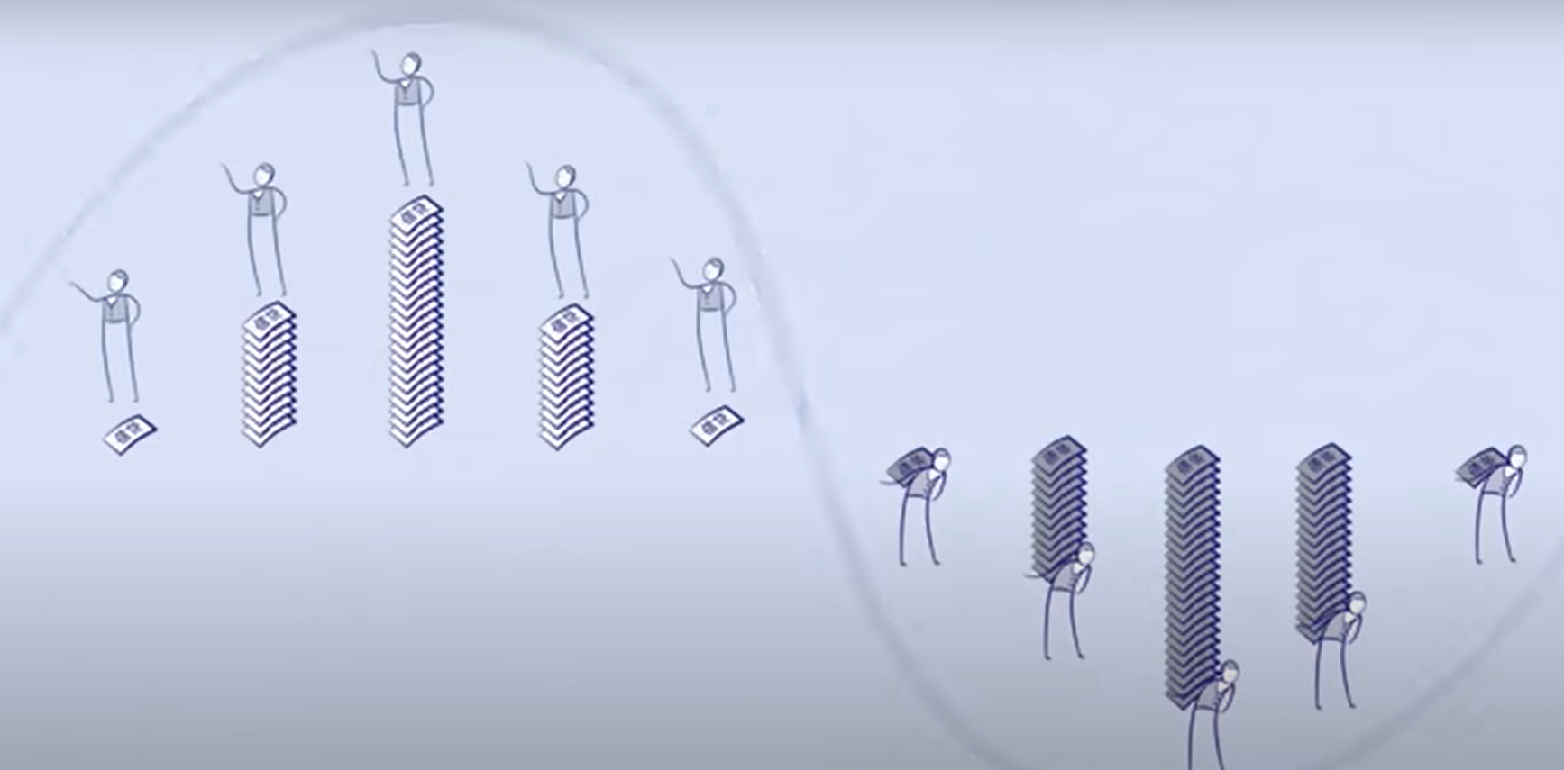
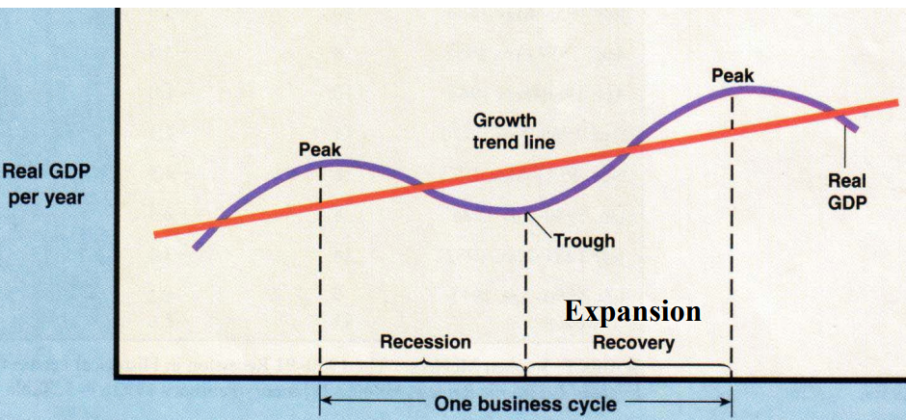
Debt, AD and the Business Cycle
Summary
The debt cycle is what causes the up and down shape of the business cycle.
English
The debt cycle that an individual goes through, ultimately is the same cycle that the economy goes through.
  Businesses, households and even government will first borrow money and spend more but eventually they will have to spend less in the future to pay back their debt.
  This means that AD will rise and fall in a way that causes the business cycle.
Note: This is not necessary knowledge for this course.

Slide 5
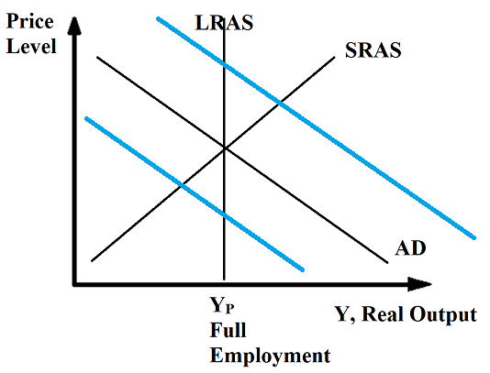
Summary
We often assume output gaps are caused by increases/decreases to AD.
This is due to the so called ‘debt cycle’ where we buy now today, but buy less in the future.
AD Increases
AD Decreases
AD will be above Y_{p} when we borrow and consume more than we earn.
However in the future, AD will be below Y_{p} when we have to consume less and pay back our loans.

Slide 6
Why do we often assume that output gaps are caused by changes in AD?
The debt cycle caused by:
  1. By borrowing we can spend more (↑C ↑I ↑G)
  2. Eventually we have to pay back what we borrowed and spend less (↓C↓I ↓G)
  Etc.
So we have cycles of higher AD and lower AD
Are AD changes the only cause of output gaps?
No, they can also be caused by supply changes.

Slide 7

Output Gaps and Unemployment
Recall, that while the AD/AS graph does not explicitly show unemployment explicitly, but we can infer unemployment from the output level.
Positive Output Gap
The economy is producing more than potential output (Actual Output > Potential Output).
Because they are producing more, businesses will employ more workers.
Therefore the unemployment rate decreases.
Negative Output Gap
The economy is producing less than potential output (Actual Output < Potential Output).
Because they are producing less, businesses will employ less workers.
Therefore the unemployment rate increases.
UR_{Actual} > NRU
There is cyclical unemployment
UR_{Actual} < NRU
There is negative cyclical unemployment

Slide 8
Y_{actual}
Actual Output is less.
Fewer workers hired.
Actual Unemployment increased. >NRU
Actual Output is normal.
Normal number of workers hired.
Natural Rate of Unemployment
Actual Output is more.
More workers hired.
Unemployment decreased. <NRU

Slide 9
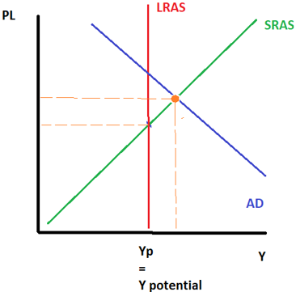
Draw the AD/AS equilibrium where actual unemployment would be BELOW the NRU? (Hint: Which one of the three equilibrium are you going to draw?)
You should have drawn the positive output gap.
Actual Output > Y_{P}
Therefore, Actual Unemployment < NRU
More stuff produced, more workers needed.

Slide 10
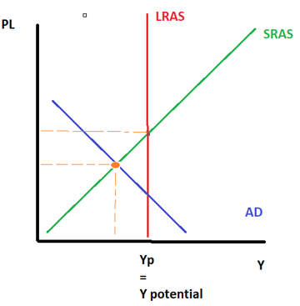
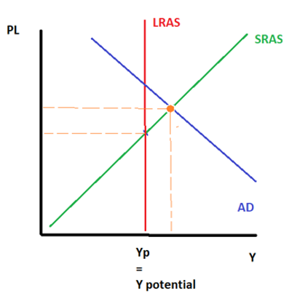
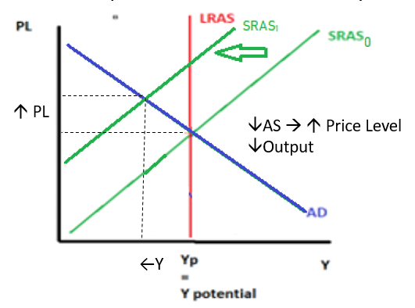
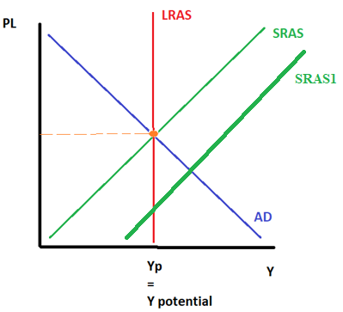
AD/AS Equilibrium Summary
 | Decreases | Increases
AD
SRAS
Negative Output Gap
Positive Output Gap
↓Output
↓ Price Level (Deflation)
↑ Output
↑ Price Level (Inflation)
AD₀
AD₁
AD₁
Y_{actual}
This is the ‘classic’ recession situation.
Y_{actual}
Negative Output Gap
Positive Output Gap
↓Output
↑ Price Level (Inflation)
↑ Output
↓ Price Level (Deflation, but the good kind)
Y_{actual}

Slide 11
Stagflation
We will explain the meaning of this odd economic term using the ADAS graph.

Slide 12
Two Causes of Inflation
 | Decreases | Increases
AD
SRAS
Negative Output Gap
Positive Output Gap
↓Output
↓ Price Level (Deflation)
↑ Output
↑ Price Level (Inflation)
AD₀
AD₁
Demand Pull Inflation
AD₁
Y_{actual}
This is the ‘classic’ recession situation.
Y_{actual}
Negative Output Gap
Positive Output Gap
↓Output
↑ Price Level (Inflation)
↑ Output
↓ Price Level (Deflation, but the good kind)
Stagflation/Cost Push Inflation
Y_{actual}

Slide 13
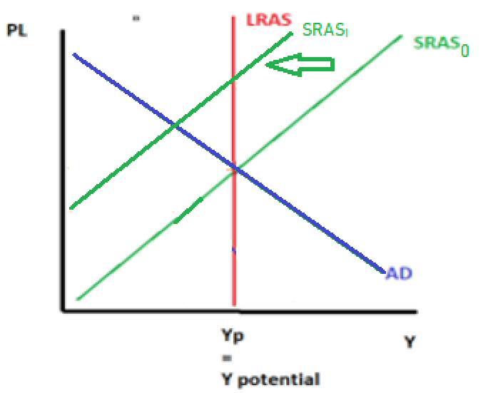

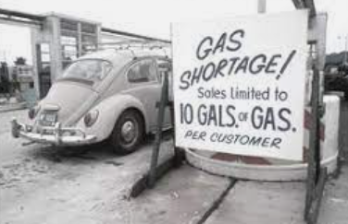
Stagflation
Summary
Stagflation is caused by fall in AS.
It is stagnation and inflation combined.
Fall in Aggregate Supply – eg. an earthquake, an oil shortage that reduces production in the economy
When there is a fall in AS this causes lower output (stagnation) and also an increase in price level (inflation).
Economists have made a special word for this:
Stagnation + inflation = ‘stagflation’
Also called ‘cost push inflation’
↑ PL
↓AS → ↑ Price Level ↓Output
Historical Context
We previously looked at the events in the 1970s, where Middle Eastern Countries (OPEC countries) stopped exporting oil to many countries, including the US. Because oil is such an important resource for almost all businesses, it reduced the ability to produce economy wide. This caused a shift of the SRAS which caused a period of high inflation and lower output!
←Y
Note: If we assume that the oil situation is short term, Yp will not shift, only Y_{actual}.

Slide 14
What is the word for economic stagnation (no, or negative economic growth) and increasing price levels at the same time?
Stagflation (stagnation + inflation)
What is the cause of this?
Decrease in Aggregate Supply.

Slide 15
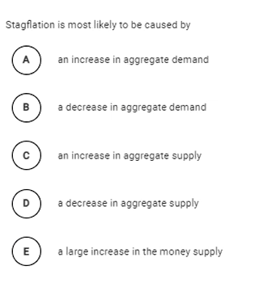
Answer D

Slide 16
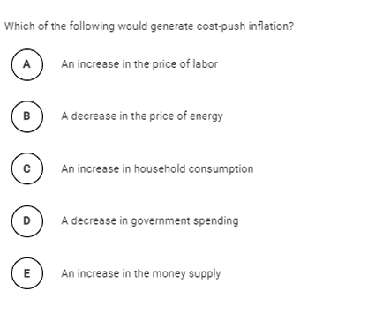
Answer A

Slide 17
Two Causes of Inflation

Slide 18
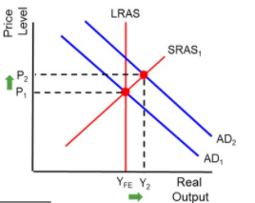

Demand Pull Inflation
Summary
Demand pull inflation is the inflation caused by an increase in AD.
We can explain both demand pull and cost push inflation using the AD/AS model. With an increase in AD caused by an increase in any of the components of AD (C+I+G+X-M), the equilibrium price level will be higher.
Eg. Prices in large cities are higher because people are more motivated to move there and will consume and invest at a higher rate, causing a higher AD.

Slide 19
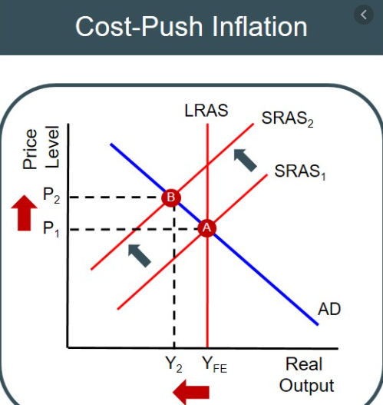
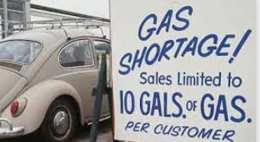
Cost Push Inflation ie. Stagflation
Summary
Cost push inflation is the inflation caused by a decrease in AS.
A decrease in aggregate supply (Eg. Increased resource costs and supply costs)
This causes lower output and a higher price level! This is also called stagflation = stagnation (no growth) + inflation
Eg.1970s US stagflation
In the 1970s the OPEC countries, for political reasons, reduced their oil supply to many countries including the United States. Because oil is such an important resource, it affected the supply of many businesses. This caused the SRAS (or arguably the LRAS) to shift to the left, causing an increase in the price level.

Slide 20
Two Causes of Inflation
 | Decreases | Increases
AD
SRAS
Negative Output Gap
Positive Output Gap
↓Output
↓ Price Level (Deflation)
↑ Output
↑ Price Level (Inflation)
AD₀
AD₁
Demand Pull Inflation
AD₁
Y_{actual}
This is the ‘classic’ recession situation.
Y_{actual}
Negative Output Gap
Positive Output Gap
↓Output
↑ Price Level (Inflation)
↑ Output
↓ Price Level (Deflation, but the good kind)
Stagflation/Cost Push Inflation
Y_{actual}

Slide 21
Causes of Inflation Review Question
What are two causes of inflation in an economy? Use graphs to show the effect
Demand Pull, Cost Push

Slide 22
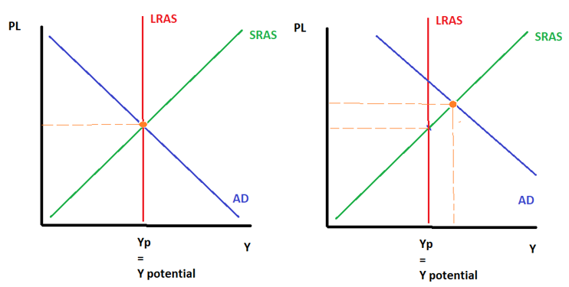
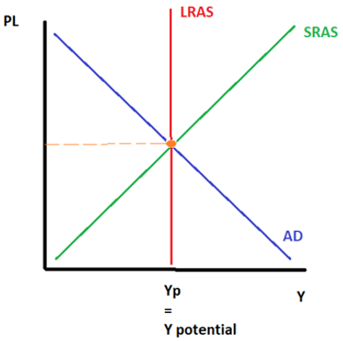
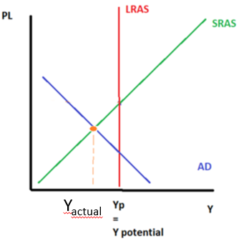
AD/AS Equilibrium - Names
Note: The different names provided are all acceptable.
There are three conditions that the economy can be in at any given time.
Demand pull inflation
3
1
Potential Output Level
2
Negative Output Gap
Positive Output Gap
Recessionary Gap
Stagflation – price level higher
Inflationary Gap - price level higher
Cost Push Inflation
Long Run Equilibrium
Demand Pull Inflation
However, stagflation is only caused by a decrease in supply
Recessionary gap = caused by either SRAS or AD falling

Slide 23
AD/AS Equilibrium Summary
 | Decreases |  | Increases
AD
SRAS
Negative Output Gap / Recessionary Gap, sometimes called a Deflationary Gap
Positive Output Gap / Inflationary Gap
Potential Output Level
While output is higher, there are concerns about inflation.
Full Employment
Long Run Equilibrium
AD₁
AD₀
Demand Pull Inflation
AD₁
This is the ‘classic’ recession situation.
Y_{actual}
Y_{actual}
Negative Output Gap / Recessionary Gap
Stagflation
Positive Output Gap but NOT Inflationary Gap
There isn’t anything negative about this situation. Output is higher and inflation is under control.
This is arguably the worst situation of all because we have low output and inflation.
Y_{actual}
Cost Push Inflation

Slide 24
Even more terms for output gaps!
Long Run Equilibrium
Full Employment, Y_{f}
Full Employment Output = Y_{f}
Potential Output, Y_{P}
Unemployment = the NRU
Negative
Below Full Employment
Recessionary Gap
Deflationary Gap (↓AD)
Unemployment is above the NRU
‘Facing high unemployment’
Stagflation (↓SRAS)
Cost Push Inflation
Positive
Above Full Employment
Inflationary Gap (↑AD)
‘Facing high inflation’ (↑AD)
Unemployment is below the NRU
Demand Pull Inflation

Slide 25
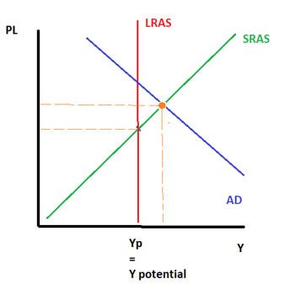
Activity
What are three other terms for a ‘negative output gap’?
Recessionary Gap
Stagflation (caused by SRAS decreasing)
Cost Push Inflation (the same as Stagflation)
Draw the AD/AS graph for an ‘inflationary gap’
You should have drawn this one, the positive output gap, because the price level is higher.

Slide 26
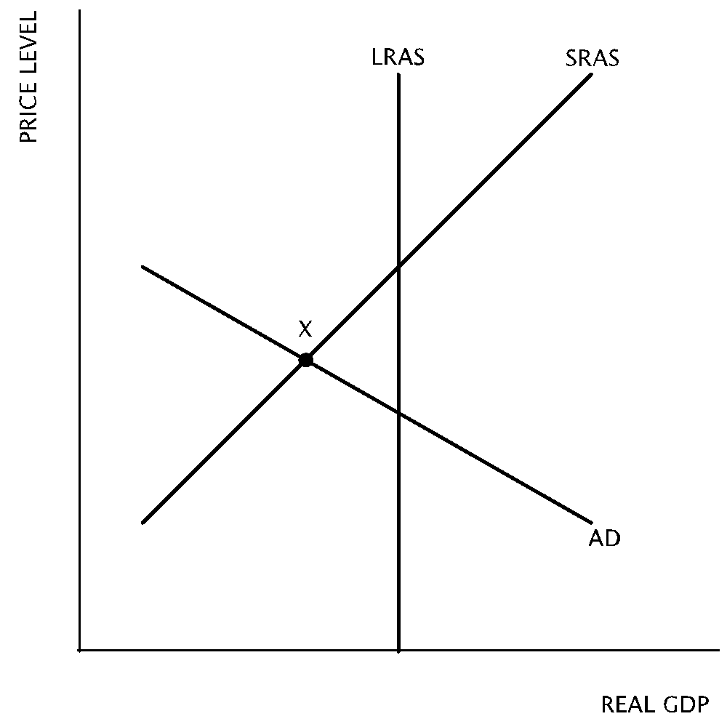
According to the graph, if the economy is at point X, there is
  long-run equilibrium with full employment.
  a recessionary gap with high unemployment.
  an inflationary gap with low unemployment.
  an inflationary gap with high unemployment.
  a recessionary gap with low unemployment.
Answer: B

Slide 27
Which of the following statements is true about a recessionary gap?
  The unemployment rate is below the natural rate of unemployment
  Aggregate output is below potential output
  Potential output is below aggregate output
  Aggregate output is above potential output
  The economy is experiencing full employment
Answer: B

Slide 28
Assuming the economy is in long-run equilibrium, which of the following changes will create an inflationary gap?
An increase in the wealth of households.
An decrease in the supply of imported oil.
An increase in government spending.
  I only
  II only
  III only
  I and III only
  II and III only
Answer: D

Slide 29

Connecting the Graphs
We have represented the three conditions of the economy using the AD/AS graph.
We should observe the connection to other concepts/models we have covered.
  Actual Unemployment vs. NRU – Natural Rate of Unemployment
  Actual Output vs Potential Output
  Business Cycle
  PPC – Production Possibility Curve

Slide 30

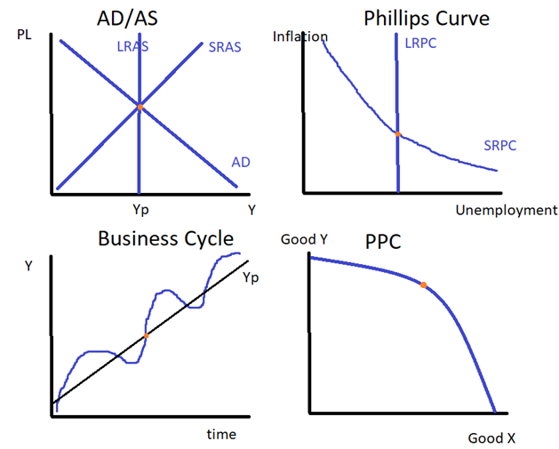
Potential Output/Long Run Equilibrium
The ‘nice, happy’ level of the economy
Actual Output = Potential Output
(NRU = Natural Rate of Unemployment = structural + frictional unemployment)
Actual Unemployment = NRU

Slide 31
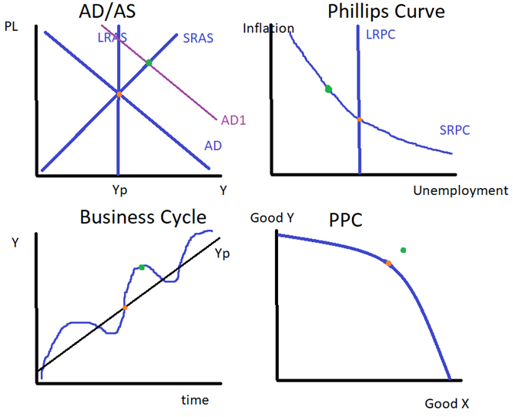
Positive Output Gap/Inflationary Gap
The ‘go go go’ level of the economy
The economy is producing more and there is lower unemployment but prices are going up. We can say the economy is overheating.
Actual Output > Potential Output
Actual Unemployment < NRU

Slide 32
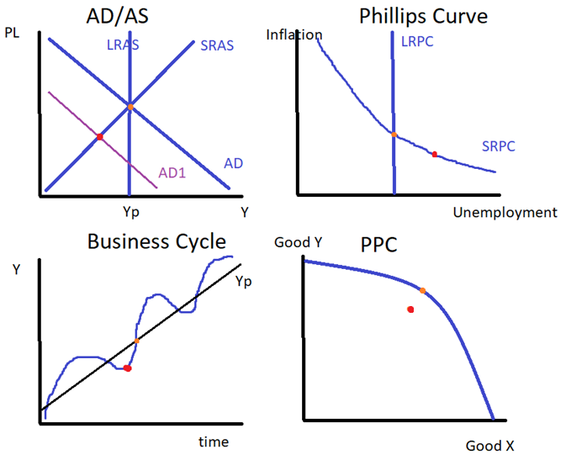
Negative Output Gap/Recessionary Gap
The ‘slowed down’ level of the economy
Actual Output < Potential Output
Note: The AD/AS graph could also show a decrease in the SRAS which would have the same effect.
Actual Unemployment > NRU
We have cyclical unemployment.

Slide 33
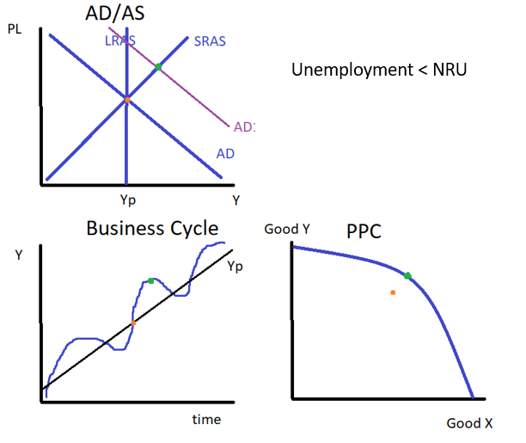
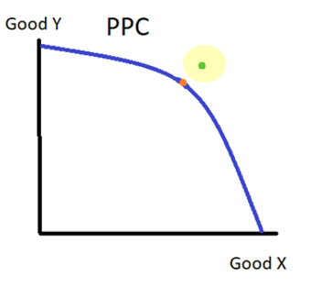
Activity
Show the result of a positive output gap using:
  PPC
  The business cycle
  Actual Employment vs NRU
  Actual Output vs Yp
  The AD/AS graph

Slide 34
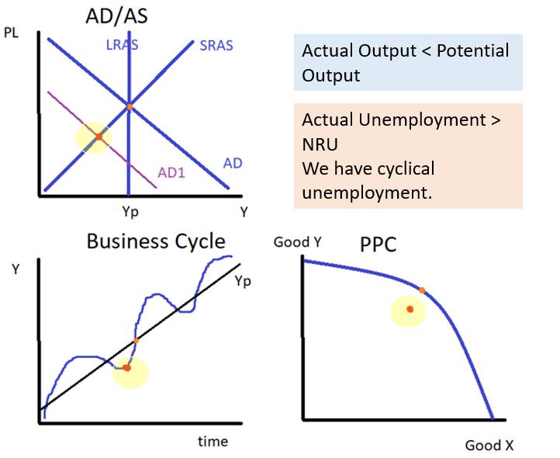
Activity
Show the result of a negative output gap using:
  PPC
  The business cycle
  Actual Employment vs NRU
  Actual Output vs Yp
  The AD/AS graph

Slide 35
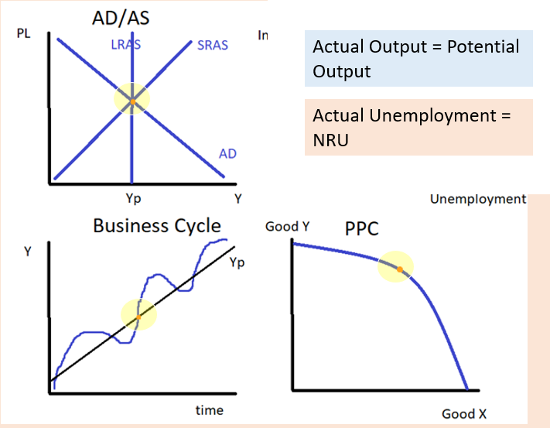
Activity
Show the state of an economy in long run equilibrium using:
  PPC
  The business cycle
  Actual Employment vs NRU
  Actual Output vs Yp
  The AD/AS graph

Slide 36
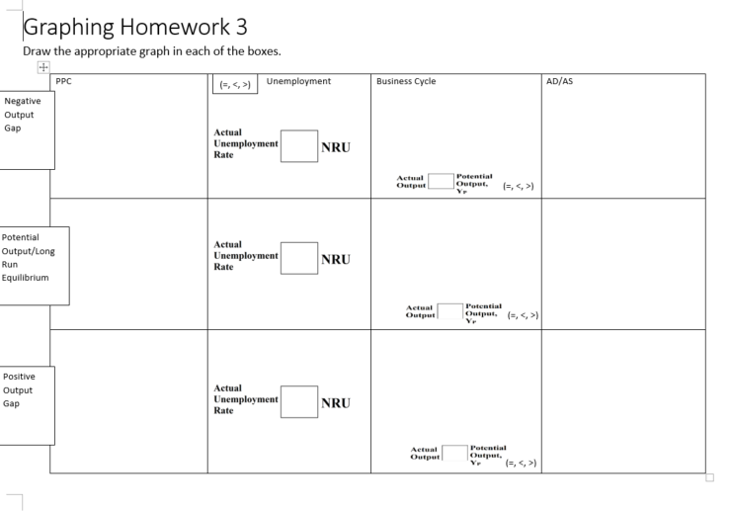
Graphing Homework #3

Slide 37
Quiz 8 Coverage
Equilibrium
  Graphing Long run Equilibrium correctly
    Label Y_{P} , PL, Y/RGDP/Real Output
  Changes to Equilibrium – effect on PL and Output
Output Gaps
  Negative Output Gap, Positive Output Gap, Potential Output/Long Run Equilibrium
  Alternate Names – Stagflation (decrease in SRAS), Inflationary Gap (increase in AD)
Connecting the Graphs
  PPC, Business Cycle, Unemployment, AD/AS Graph
    Understand how these graphs relate (just like the homework)

Slide 38
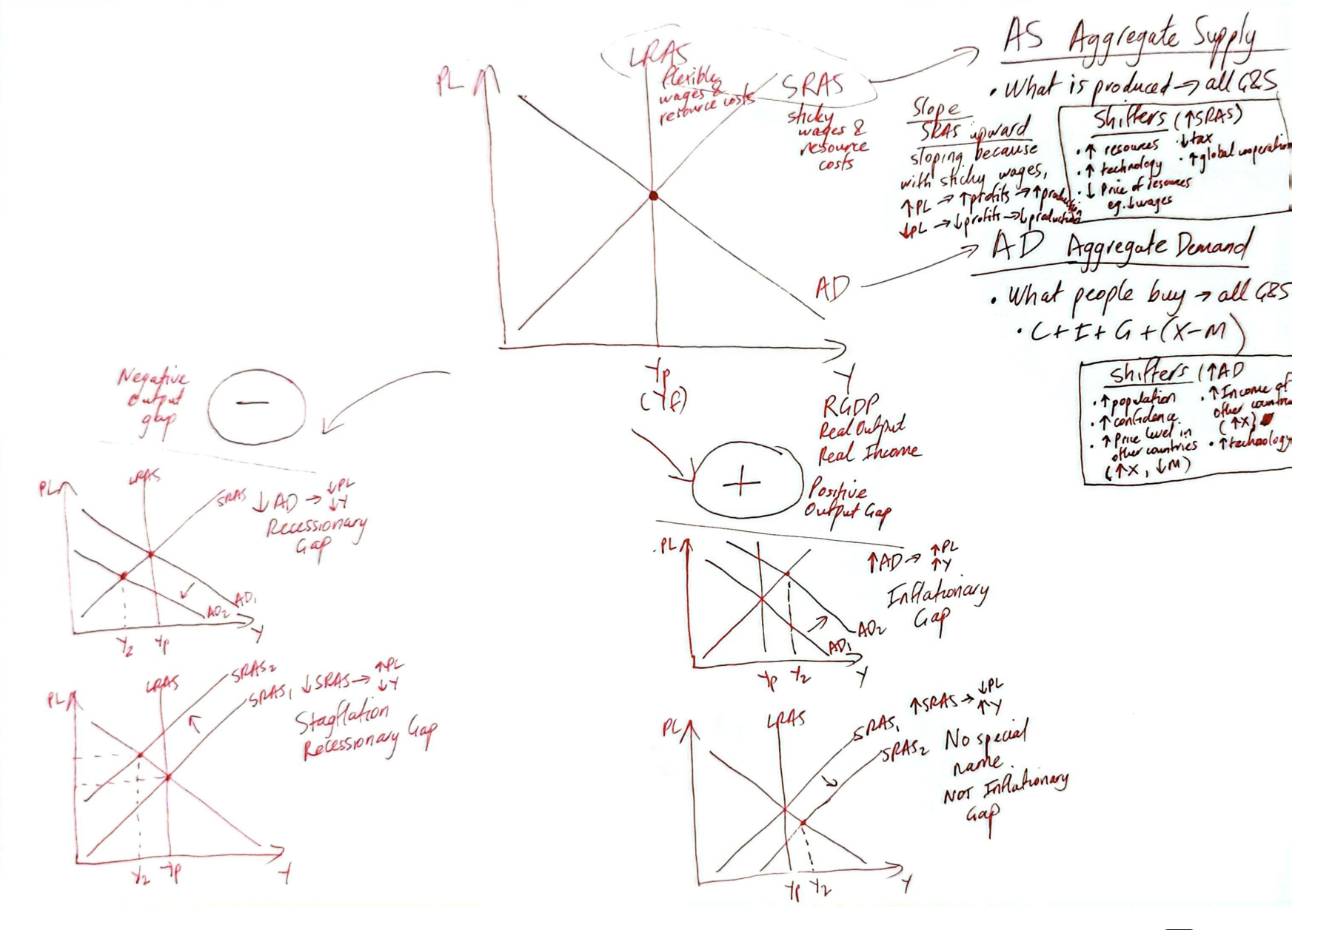

Slide 39
Long Run Self Adjustment to Equilibrium

Slide 40
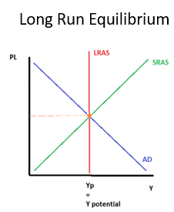
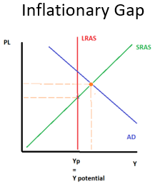
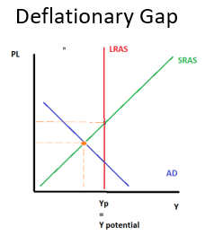
Self Adjustment to Equilibrium
  What happens to the economy when it is not at long run equilibrium/potential output level?
Through a mechanism not unlike what we see in microeconomics, the macro economy automatically self adjusts to return back to the long run equilibrium.
We will see how this occurs.
Long Run Equilibrium
Short Run Equilibrium
Short Run Equilibrium
Recessionary Gap
Long Run
Long Run
Summary
The macro economy always adjusts back to the Long Run Equilibrium

Slide 41
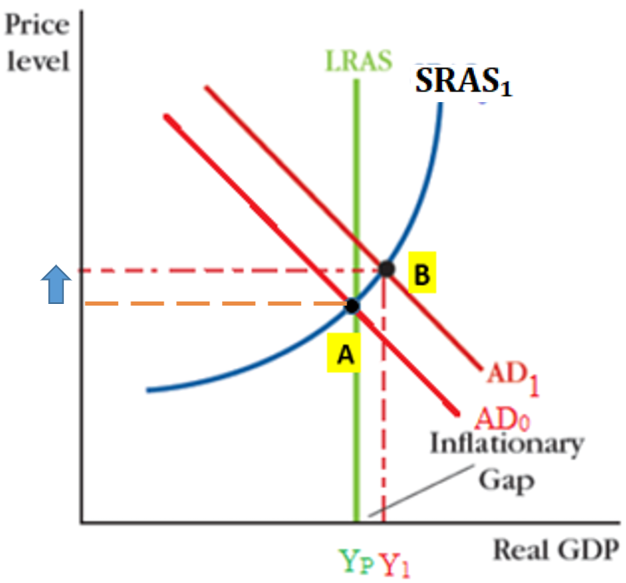
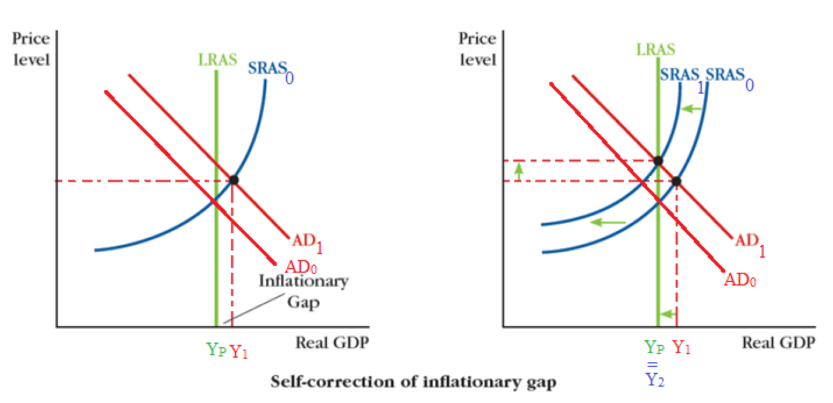
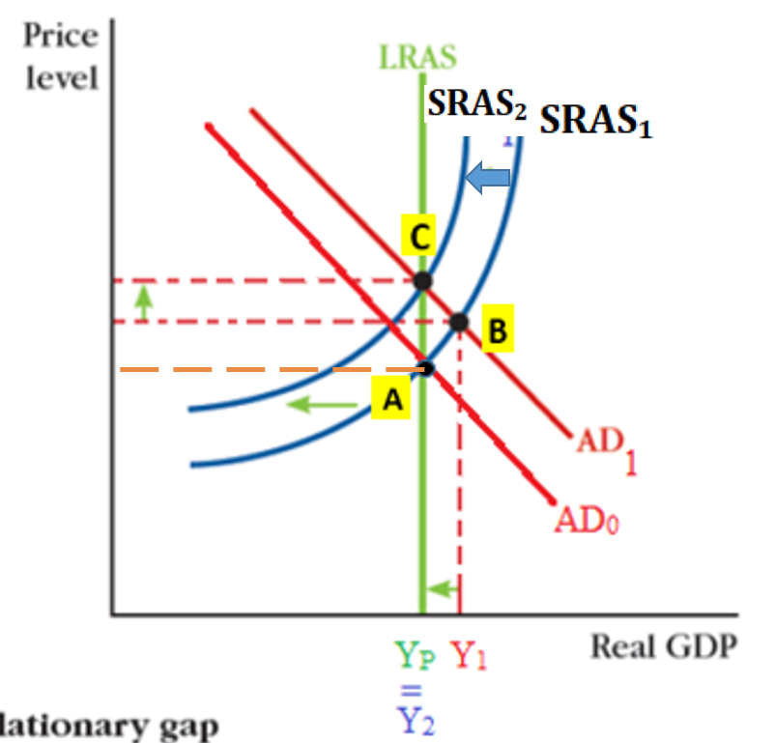
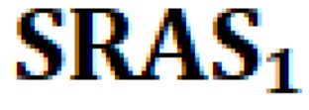

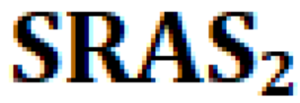
Long Run Self Adjustment to Equilibrium – Positive Output Gap
Short Run Equilibrium
Long Run Equilibrium
Short Run – Output Gap
↑AD
→ RGDP/Real Output/Y, ↑PL
(Recall that in the short run, the wages are somewhat fixed; sticky wages)
Long Run – SRAS Adjusts -> back to LR Equilibrium
However, once workers are able to renegotiate their contracts, the price of labor will increase.
  Eg. You worked in a factory and the price level has increased 10%. You will obviously ask for at least a 10% raise for the next contract negotiation.
This will push the SRAS to the left (increase in input costs)
We have returned to Y_{p} level output.
Note: Output is the same but price level is now higher.
Summary
When the sticky wages stop being sticky, SRAS will shift and the economy returns to a long run equilibrium.

Slide 42
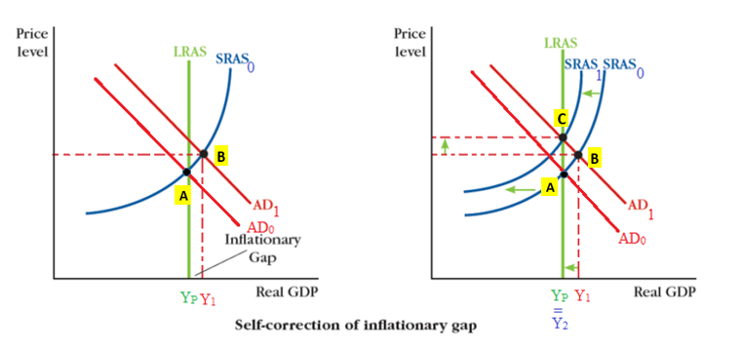

Short Run Equilibrium
Long Run Equilibrium

Slide 43
Short Run Equilibrium
Long Run Equilibrium

Slide 44
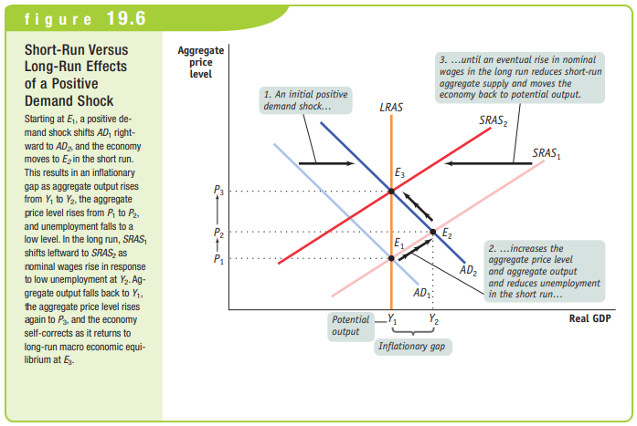
Page 196 Krugman Book

Slide 45
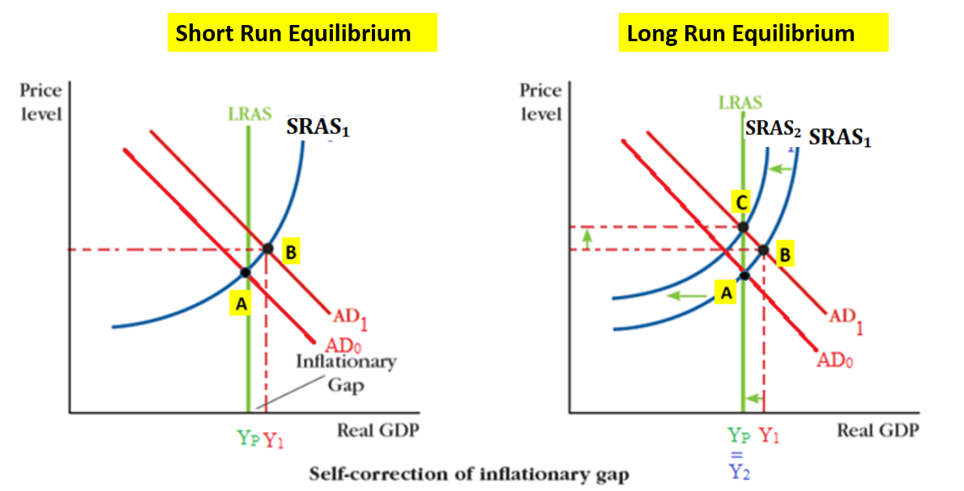
Draw and explain what occurs when the economy naturally readjusts when there is an inflationary gap.

Slide 46
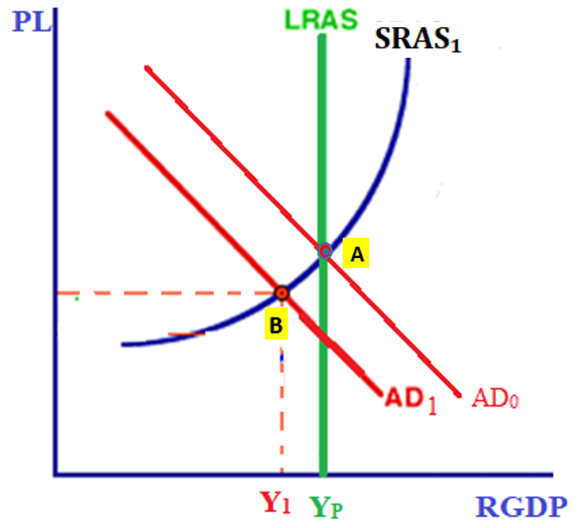
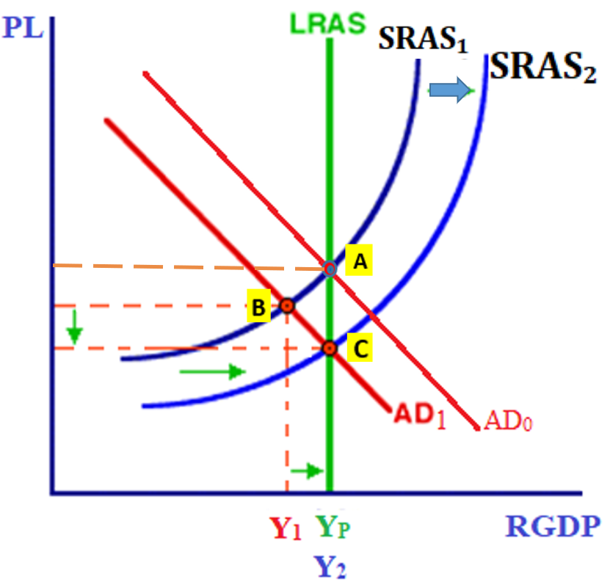
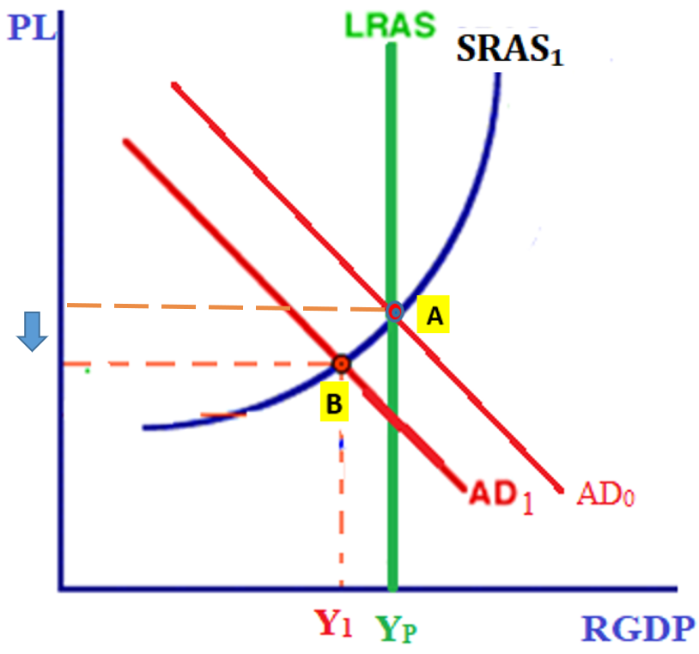
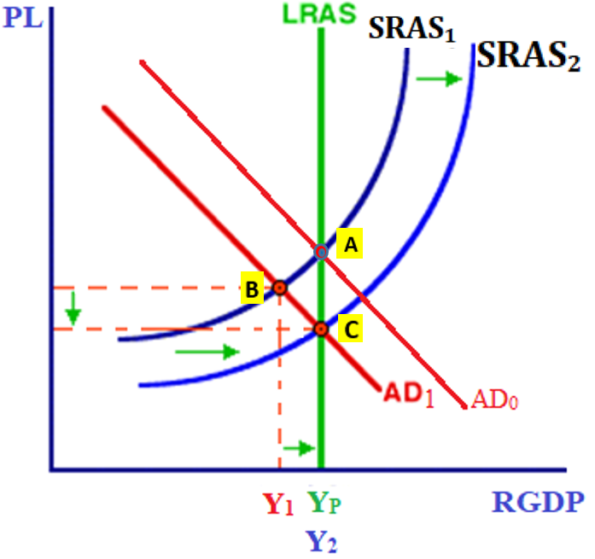
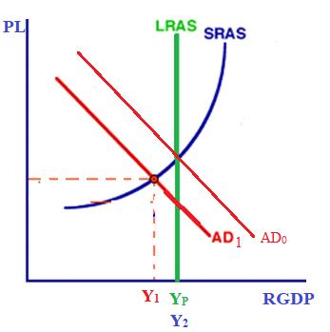



Long Run Self Adjustment to Equilibrium – Negative Output Gap
Short Run Equilibrium
Long Run Equilibrium
Short Run
↓The price level has gone down.
In the short run, because of sticky wages, producers have produced less, causing the output gap.
Long Run
However, once employers are able to renegotiate the contracts, the price of labor will decrease.
  Eg. Due to lower demand, the price level has decreased 10%. Businesses are charging less for their goods and eventually are able to lower the wages so their costs go back to normal.
The lower the wages, this will push the SRAS to the right (decrease in input costs)
We have now returned to the Y_{P} output level.
Note: The output will be the same but the price level lower.
Macroeconomic self adjustment– when wages go down in the long run, this will cause SRAS to shift to the right, and return back to long run equilibrium.

Slide 47
Short Run Equilibrium
Long Run Equilibrium

Slide 48



Conclusion – Self Adjustment
The economy self adjusts when SRAS moves, left or right, returning to Y_{P.}
Positive Output Gap (caused by AD increase)
Negative Output Gap (caused by AD decrease)

Slide 49

What about the long run effect of changes to SRAS?
If there is a positive or negative output gap caused by change to SRAS.
The SRAS will simply shift back, because the change to SRAS was only a short term change.
Summary
For output gaps caused by SRAS changes, the SRAS curve will shift back to it’s original position because the change was only temporary.

Slide 50
Draw and explain what occurs when the economy naturally readjusts after there is a recessionary gap. Completely label a diagram.
Recessionary gap typically means ↓AD -> ↓PL -> ↓wages and res costs (LR) -> ↑SRAS -> Output level returns back to Yp

Slide 51


Effects on PL and Y
What is the short run effect of an increase in consumption on price level and output?
Increase price level, increase output
What is the long run effect of an increase in consumption on price level and output?
Increase price level, no change to output

Slide 52
What is the short run effect of a decrease to net exports on price level and output?
decrease price level, decrease output
What is the long run effect of an increase in consumption on price level and output?
decrease price level, no change to output

Slide 53

Inflationary Gap
Recessionary Gap caused by SRAS ie. Stagflation
Recessionary Gap

Slide 54


Slide 55
Economic Opinions on Recession

Slide 56


“We’re in a recession! What should we do?”
Recall that economics is not an exact science and that there is often difference of opinion.
There is disagreement about whether the economy should be left alone or whether the government should manage the economy.

Slide 57


Self Adjustment – Classical and Free Market View
Classical / free marketer view– the economy is always naturally self adjusting and doesn’t need to be managed.
So if the economy naturally adjusts to the long run equilibrium, the economy takes care of itself?
This is the classical view, which believes that governments should just let the economy take care of itself.
However starting in the 20th century with the Great Depression, there has been a movement toward government intervention.
Free Market Economics
Modern day economists who still believe that the market should be left alone, are often called ‘free market economists’ or ‘free marketeers’. Milton Friedman (right) was a highly influential 20th century economist who largely advocated for free markets and less government intervention.

Slide 58
Is government intervention considered necessary in the classical view and the free market view?
No, the economy self adjusts naturally.

Slide 59


The Great Depression
50 Amazing Photos of the Great Depression - YouTube
The Great Depression lasted a long time!
It lasted for many years, and there was a lot of pain and suffering for ordinary people.
This made many economists question – should we wait for the economy to self adjust?
Economists began to argue for more government intervention.
Summary
The Great Depression made people question the idea that the economy will take care of itself.

Slide 60


Slide 61


Slide 62


Slide 63


Slide 64


Slide 65


Slide 66


Slide 67


Slide 68


Slide 69


Slide 70


Slide 71


Slide 72


Slide 73


Slide 74


Slide 75


Slide 76


Slide 77


Slide 78


Slide 79


Slide 80


Slide 81


Slide 82
How did the Great Depression affect how people thought about regulating the economy?
Because the Great Depression was so severe and lasted a long time.
It made people wonder if there should be more government intervention.

Slide 83





Economic Intervention and John Maynard Keynes
Summary
Classical/Free Market Belief: The economy adjusts naturally
John Maynard Keynes: The economy adjusts too slowly so government should intervene.
  The Great Depression starting in 1929 was not a good period for classical theory, because it lasted for a long period and was very severe even though classical economists claimed that the economy would always take care of itself.
  John Maynard Keynes
  A new way of thinking, lead by John Maynard Keynes, who founded a whole school of economics called ‘Keynesian Economics’ advocated for government intervention and famously said: “In the long run we’re all dead.”
  What he meant by this was that the long run is often too far away, and that the government should intervene in the economy, especially in the case of a recession.
  Keynes’ theories have continued to be extremely influential, even to this day!
Keynes – 60 second economics
1.42 seconds also

Slide 84
What do Keynesians believe when it comes to managing the economy?
Even though the economy will self adjust to long run equilibrium, it will take too long!
Keynes supported government intervention to manage the economy when there is a recession.
(We will soon learn about how the government can intervene.)
What was the famous quote of John Maynard Keynes?
In the long run, we’re all dead.
Do many of Keynes’ ideas continue to be relevant today?
Yes.

Slide 85

Fiscal Policy
Fiscal Policy will be our first look at how the government can help to manage the economy

Slide 86



Two types of Government Policy
Summary
Two main methods of intervention:
Fiscal Policy (Unit 3) and Monetary Policy (Unit 4)
Government can step in to increase AD in two main ways:
Fiscal Policy (FP)
Increases or decreases AD through taxes and government spending.
↑↓G, ↑↓Gov transfers, ↑↓ T
Monetary Policy (MP)
Increases or decreases AD by changing interest rate.
Lowers or increases the interest rate. (How is this done? We’ll look at this in future chapters.)
When the interest rate is lower, cost of borrowing is lower which has the result that:
  Businesses can invest more (↑I)
  Consumers can purchase interest sensitive things such as houses and cars (↑C)
AD = C + I + G + (X-M)

Slide 87
Fiscal Policy Policies
Income tax – taxing individuals who earn income for selling factors of production.
Corporate Tax – taxing firms.
Sales taxes – taxes on goods and services, which are typically higher on goods such as alcohol, cigarettes and other discouraged products.
Tariffs – taxes on foreign goods. A higher tax will discourage imports and increase AD. (However, there is no saying what other countries will do when they see you are taxing them more.)
Fiscal Policy tries to move AD to the left or right to restore long run equilibrium.
This is done through:
  ∆ Taxes (households have less money for consumption (C), businesses less money for investment (I))
  ∆ Government spending (G)
  ∆ Government transfers
Summary
There are three parts of fiscal policy – taxes, government spending and government transfers.
Effect:
AD = C + I + G + (X-M)
Eg. On infrastructure, research and development, schools, hospitals etc.
Effect:
AD = C + I + G + (X-M)
Eg. Unemployment benefits, retirement benefits, disability etc.
Note: Government expenditure = government spending (G) + government transfers
Effect:
AD = C + I + G + (X-M)

Slide 88
What is fiscal policy and what are the three parts that can be used?
Government can increase or decrease AD through:
  taxes
  government spending
  government transfers
What are some examples of some different types of taxes that might be paid to the government?
Income tax (tax on our wages), sales tax (tax on things we buy), tariffs (on foreign goods), corporate tax (tax on firm profits) etc.

Slide 89

Tax Terms
Summary
There are multiple terms that actually have the opposite effect of tax.
There are a few terms that can actually have the opposite effect of tax.
  Subsidy – opposite of tax. Government giving money to businesses
  Tax credit – reduces the amount of tax paid
  Tax rebate – a tax refund
  Tax exemption – don’t have to pay tax
  Tax deduction – reduces the amount of tax paid
For this course, it is not important to know the exact differences between these (this is more of an accounting topic) and so you can treat these as having the opposite effect of a tax.

Slide 90
If the government increases the tax rebates given to certain businesses, what is the effect on the AD?
This will reduce the tax, therefore increase AD.
If the government decreases subsidies to businesses, what is the effect on AD?
This will decrease the amount of money given to businesses, so the AD will decrease.
If the government reduces tax credits for green energy businesses, what is the effect on the AD?
This will increase the tax paid and therefore reduce AD.

Slide 91


Expansionary Fiscal Policy
Fiscal Policy and Stimulus: Crash Course Economics #8 - YouTube
PL
Expansionary Fiscal Policy
When the economy is in a recession/negative output gap (caused by a fall in AD), the government tries to increase AD.
This is called, expansionary fiscal policy.
This is to correct the problem of low output and unemployment.
PL₂=PL₀
PL₁
Expansionary Fiscal Policy
Tax Cuts (people have more money to spend)
Government Expenditure
  Government Spending (↑G)
    Education, Infrastructure, Healthcare, Military, Police, Research, etc.
  Increased Transfer Payments
    Transfers to unemployed, disabled, retired etc.
Y₁
Y_{P} = Y₂
Y
Historical Context:
Many people believe that the government spending in World War II helped the US to get out of the Great Depression. This could therefore be considered one of the early examples of fiscal policy!
Summary
Expansionary fiscal policy is used to close a negative output gap caused by a fall in AD.
Why? To fight low output/high unemployment
1min45 Impact of World War II on the U.S. Economy and Workforce

Slide 92
Expansionary fiscal policy seeks to __________ AD.
Increase
An example of expansionary fiscal policy would be to _________ tax.
Decrease
Expansionary fiscal policy should be used to correct a __________ output gap.
Negative output gap / recession
The problem we are most likely addressing with the expansionary FP is ____________.
Unemployment

Slide 93


Contractionary Fiscal Policy
What are the three main economic objectives of government?
Economic Growth (↑GDP)
Low Unemployment
Low and stable inflation
  Therefore, when we have a positive output gap caused by an ↑AD (inflationary gap), the government wants to control inflation.
Fiscal policy targeted at slowing down an overheating economy is referred to as contractionary fiscal policy.
  While you may think that economic growth is always a good thing, excessive AD can cause inflation which governments prefer to minimize.
Contractionary Fiscal Policy
Contractionary Fiscal Policy Method:
↓ Government Expenditure
  ↓Government Spending (G)
  ↓Government Transfers
↑Tax
PL₁
PL₂
=PL₀
Summary
Contractionary Fiscal Policy is used to shift AD to the left to correct a positive output gap.
Why? To control inflation.
Yp
Y₁
=
Y₂

Slide 94
Contractionary fiscal policy seeks to __________ AD.
Decrease
An example of contractionary fiscal policy would be to _________ government transfers.
Decrease
Contractionary fiscal policy should be used to correct a __________ output gap.
Positive
The problem we are most likely addressing with the contractionary FP is ____________.
Inflation

Slide 95




An analogy for Expansionary and Contractionary Fiscal Policy
The economy
The economy
In a negative output gap the government wants to expand the economy!
Therefore, the will use Expansionary Fiscal Policy.
In a positive output gap, the government wants to contract the economy.
Therefore, will use Contractionary Fiscal Policy.
The policy
The policy

Slide 96



Fiscal Policy Summary
Expansionary = moving AD to the right
When? Negative Output Gap
Why? To fight a recession and fight against unemployment.
Contractionary = moving AD to the left
When? Positive Output Gap
Why? To fight inflation.
Methods of implementing fiscal policy
  Tax
  Government Spending
    Remember: AD = C+I+G+(X-M)
  Government Transfers (social welfare, food stamps etc.)
    This money will then be spent by households, hopefully at a higher rate than the people being taxed were spending it.
LRAS
SRAS
Summary
Fiscal policy = increasing/decreasing AD through taxes (T), Government spending (G) and government transfers
Expansionary – increase AD to fight unemployment
Contractionary – decrease AD to fight inflation

Slide 97

The Mexican economy is in a recession. As the chief economic advisor of Mexico, what kind of fiscal policy would you recommend?
Expansionary fiscal policy. Cut taxes and increase government spending and social welfare.
LRAS
SRAS

Slide 98

The economy is operating beyond potential output and inflation appears to be a risk. What kind of fiscal policy would you recommend?
Contractionary fiscal policy. Increase taxes and decrease government spending.

Slide 99

Fighting a Negative Supply Shock/Stagflation
Summary
Governments find it difficult to fight stagflation because there is no option that solves inflation and unemployment at the same time.
Recall that a negative supply shock causes stagflation – higher price level and lower output.
In this situation the government has a tough decision to make!
  If they use expansionary fiscal policy they will improve output and help unemployment, but cause even more inflation!
  If they don’t use expansionary fiscal policy, the economy will probably suffer from lower output/unemployment.
1
↓SRAS → Inflation
Expansionary Fiscal Policy → ↑AD→More inflation!
2
 | Unemployment | Inflation
Do Nothing | Bad | Bad
Expansionary FP | Good | Very Bad
Contractionary FP | Very Bad | Good

Slide 100
What type of output gap is more difficult for the government to fight using fiscal policy?
Stagflation ie. A negative output gap caused by a negative supply shock
What is the problem with using expansionary fiscal policy to fight a negative supply shock?
Even though it might correct the output problem, it will make inflation even worse!

Slide 101

contractionary – less government spending.
Expansionary – more social welfare to unemployed people.
Contractionary – increase in tax.

Slide 102

Module 20
3. Answre: B
4. Answer: B
5. Answer: A. A rebate is essentially a ‘tax refund’. Therefore your real tax rate is less, putting more money in the hands of households to spend. This will increase AD.

Slide 103

Problems with Fiscal Policy
Political Lags
In many countries, changes to national tax and government spending policies have to be passed through parliament which can be slowed down by political disagreement.
Implementation Lags
Certain fiscal policy often comes with a time lag. Furthermore, even when these laws are passed there can be time before it takes effect. Eg. Building a road (government spending) can take a long time to plan and implement.
Time Lags
Data Lags
Most economic indicators are ‘lagging indicators’ in that they give us information about the past rather than future. Therefore, economic data will often have a delay in informing us about the economy.
Negative Supply Shocks
We saw that a government can respond to a positive or negative demand shock through fiscal or monetary policy.
How can a government fight a negative supply shock?
Because a negative supply shock causes an increase in price level, a government attempt to increase AD will further increase price level. This is certainly not desirable! The answer is that supply shocks do not have as obvious a solution.
Definition: Fiscal Lag – fiscal policy won’t be implemented immediately because of limitations of data collection, the political process and logistical barriers

Slide 104
What is one reason that fiscal policy often has a time lag?
Political reasons – eg. the time to pass through congress
Planning and implementation time – eg. it is not immediate to change the tax rate because all the agencies have to be informed of the new policies etc.
Data Lags – most economic indicators take time to collect and inform us about the past.

Slide 105

Module 20
The speed of the federal disaster relief will reduce the effect of lags that fiscal policy sometimes comes with.
However the legislated (politicians have to come to an agreement) relief will have more of a lag and therefore be less effective.

Slide 106

Answer: E

Slide 107

Module 20
A) This is actually somewhat true! If we look at the AD/AS graph. If we continue to increase AD, without an increase in AS, we will see inflation.
B) However, expansionary fiscal policy is usually used when there is a negative output gap caused by a fall in AD. Therefore inflation is not a concern because the price level has typically fallen during the recessionary gap.

Slide 108

Does Economic Intervention Work?
In the above graph we can see that unemployment reached historic highs during the Great Depression and that this level has never been reached, even in the 2008/09 financial crisis.
Some would cite that as evidence that current methods of government intervention have some effect and that the effects of recession will be less than if the government does nothing.
  Governments are able to control the size of a recession via economic intervention which includes fiscal policy.
The Great Depression and Economic Management
The Great Depression and the events around this period are still debated but many believe that the government response was too slow.
In fact, it was only during World War II which increased economic output and created jobs that the economy was really able to recover/rebound.
Summary
While there is still disagreement, many believe that economic intervention has reduced the size of recessions like we saw in the Great Depression.

Slide 109


Fiscal Policy Review
Purpose of Fiscal Policy
Fiscal Policy tries to move AD to the left or right to restore long run equilibrium.
This is done through:
  ∆ Taxes (households have less money for consumption (C), businesses less money for investment (I))
  ∆ Government spending (G)
  ∆ Government transfers
Expansionary Fiscal Policy
  Government seeks to increase AD in a recession (and unemployment becomes a problem)
    ↑ AD=C+I+ ↑ G+ (X-M)
    Government cuts taxes and increases spending
Contractionary Fiscal Policy
  Government seeks to decrease AD when the economy is overheating (and excessive inflation becomes a risk)
    ↓ AD=C+I+ ↓ G+ (X-M)
    Government increases taxes and cuts spending
Problems with Fiscal Policy
Fiscal Lags
Data collection and analysis delay
Political delay
Implementation delay
Problems addressing stagflation
  only makes inflation worse!

Slide 110


A) Positive Output Gap.
B) Contractionary Fiscal Policy (decrease G and increase T)
C) Government Spending
Government Transfers
Tax
D) decrease Government Spending
Decrease government transfers
Increase tax

Slide 111

Answer: E

Slide 112

Answer: A

Slide 113
Quiz 8 Coverage
Equilibrium
  Graphing Long run Equilibrium correctly
    Label Y_{P} , PL, Y/RGDP/Real Output
  Changes to Equilibrium – effect on PL and Output
Output Gaps
  Negative Output Gap, Positive Output Gap, Potential Output/Long Run Equilibrium
  Alternate Names – Stagflation (decrease in SRAS), Inflationary Gap (increase in AD)
Connecting the Graphs
  PPC, Business Cycle, Unemployment, AD/AS Graph
    Understand how these graphs relate (just like the homework)

Slide 114
Fiscal Policy and Stabilization Policy
Fiscal policy is one kind of stabilization policy.

Slide 115

A New Term:
Stabilization Policy
Summary
Stabilization policies is when the government decreases the size of output gaps so the economy is closer to Y_{P}
This causes the business cycle to be ‘flatter’.
Governments try to reduce the size of output gaps so the economy can be closer to potential output – this is stabilization policy.
Fiscal policy is one of the kinds of stabilization policy.
It makes the business cycle appear flatter and closer to potential output.
Actual Output without stabilization policies.
Actual Output with stabilization policies.
We can show the effect of stabilization policy on the business cycle. It causes the business cycle to be flatter – the points will be closer to Potential Output Yp

Slide 116

Fiscal Policy
Stabilization Policy
is a
Why?
Because it tries to bring us closer to Yp.

Slide 117
Two types of Stabilization Policy
Summary
Two main methods of intervention:
Fiscal Policy and Monetary Policy
Both affect the AD.
Government can step in to increase AD in two main ways:
Fiscal Policy (FP)
Increases or decreases AD through taxes and government expenditure.
↑↓ G and gov transfers, ↑↓ T
Monetary Policy (MP)
Increases or decreases AD by changing interest rate.
Lowers or increases the interest rate. (How is this done? We’ll look at this in future chapters.)
When the interest rate is lower, cost of borrowing is lower which has the result that:
  Businesses can invest more (↑I)
  Consumers can purchase interest sensitive things such as houses and cars (↑C)
AD = C + I + G + (X-M)

Slide 118



Two Types of Stabilization Policy
Increase AD in a negative output gap.
Decrease AD in a positive output gap.
Summary
Both Fiscal Policy and Monetary Policy aim to do the same thing; change AD to stabilize the economy.
Fiscal Policy
Increase/decrease AD using
  Tax -> affects C and I
  Gov Expenditure
    Gov spending (G)
    Gov transfers -> affects C and I
Monetary Policy
Increase/decrease AD using
  Interest Rates -> affects C and I

Slide 119
What is meant by a stabilization policy?
This is where the government tries to keep the economy closer to Y_{P} by reducing the size of output gaps.
How can fiscal policy be considered a type of stabilization policy?
Fiscal Policy is stabilization policy because it reduces the size of output gaps through changing AD (Expansionary FP in a recession and Contractionary FP in an inflationary gap).
When the economy automatically adjusts back to long run equilibrium in the long run, should this be considered a type of stabilization policy?
No. It does not involve any policy because it happens without a government.
What is the common thing between fiscal policy and monetary policy?
They both seek to increase or decrease AD.
How will the business cycle look different when there is stabilization policy?
It will look flatter.

Slide 120
Automatic Stabilizers
Some fiscal policy occurs acts similar to the autopilot on an airplane. It makes minor adjustments without the need for the pilot.

Slide 121


Slide 122


Fiscal Policy
We can split fiscal policy into two main types.
Note: Setting new tax policy is discretionary, however, without any change, the tax rates will operate on their own.
Discretionary Fiscal Policy
Automatic Stabilizers
Discretionary Fiscal Policy – choices have to be made by government about what course of action to take (including taking no action)
Automatic stabilizers / Non-discretionary Fiscal Policy – fight recessions and ‘economic overheating’ automatically without needing new decisions
Can be referred to as:
Non-discretionary fiscal policy
Automatic stabilizers
Summary
There are two types of fiscal policy:
Automatic stabilizers – work without any decision making.
Discretionary fiscal policy – requires decision making.

Slide 123
What does discretionary mean?
Discretion = similar to decision
Discretionary = where decisions must be made by individuals
What is an example of a discretionary fiscal policy that governments might use?
Eg. Building a school, increasing military spending, building a road
In terms of fiscal policy, what is the opposite of discretionary?
Automatic Stabilizers
What new decisions does the government have to make for automatic stabilizers to take effect?
None!

Slide 124


Automatic Stabilizers and the Business Cycle Visualized
Summary
Parts of automatic stabilizers: Tax and government transfers
They work without any more decisions being made.
Some parts of fiscal policy are ‘automatic’.
  Because once the policy is set, they will be effective without more government decision making.
What are the parts of automatic stabilizers?
Tax Collected
There are many different types of tax, the main ones being income tax and corporate tax
2. Government transfer payments
A large part of this will be social security ie. Giving money to poor people.

Slide 125
Fiscal Policy – Automatic Stabilizers vs Discretionary Fiscal Policy
Tax
  Income Tax, Corporate Tax, Tariffs
  Changes to tax policy
Government Spending
  Building Roads, Schools, Hospitals
  Military Spending
  Public Departments (eg. Tax Bureau)
Government Transfers
  Social Security Transfers (eg. for the poor)
  Subsidies to businesses (eg. small businesses)
  Changes to government transfer policy
Automatic Stabilizer
Discretionary Fiscal Policy
Discretionary
Discretionary
Discretionary
Automatic Stabilizer
Automatic Stabilizer
Discretionary

Slide 126
Are automatic stabilizers different from fiscal policy?
No, just a type of fiscal policy.
True or False? The collection of tax based on an already established tax system is an automatic stabilizer.
True
True or False? Changes to the tax policy that are made by a government in the current year, which results in more/less tax, is an example of an automatic stabilizer.
False. Because new decisions were made, this is not an automatic stabilizer.

Slide 127
Example - Tax and Gov Transfer Policy
We are a government and we make these policies:
Tax policy
  Everyone pays 10% tax
Social Security policy
  People who make less than $10,000 per year will receive $2000.
Now let’s see how this policy can help to adjust the economy when we have output gaps!

Slide 128



Positive Output Gap – Automatic Stabilizers
Summary
In a positive output gap, the automatic stabilizer fiscal policy will be contractionary.
In a positive output gap:
RGDP increases -> Income increases and people are wealthier.
Tax:
↑ Incomes -> ↑ Tax
  Eg. Before: 10% of $50,000 = $5000
  After: 10% of 60,000 = $6000
↑Tax → ↓C,I → ↓AD → ↓GDP
Social Security:
↑ Incomes -> ↓ Government Transfers
  Eg. Before: 100 people make < $10,000
  After: 70 people make < $10,000
↓Government transfer payments → ↓C,I → ↓AD → ↓GDP
Policies
Tax policy
  Everyone pays 10% tax
Social Security policy
  People who make less than $10,000 per year will receive $2000.
↑Tax ↓government transfer payments
= Contractionary Fiscal Policy (Automatic Stabilizer Fiscal Policy)

Slide 129
Negative Output Gap – Automatic Stabilizers
Summary
In a negative output gap, the automatic stabilizer fiscal policy will be expansionary.
In a negative output gap:
RGDP increases -> Income increases and people are wealthier.
Tax:
↓ Incomes -> ↓ Tax
  Eg. Before: 10% of $50,000 = $5000,
  After: 10% of 40,000 = $4000
↓ Tax → ↑C,I → ↑AD → ↑GDP
Social Security:
↓ Incomes → ↑ Government Transfers
  Eg. Before: 100 people make < $10,000
  After: 150 people make > $10,000
↑Government transfer payments → ↑C,I → ↑AD → ↑GDP
Policies
Tax policy
  Everyone pays 10% tax
Social Security policy
  People who make less than $10,000 per year will receive $2000.
↑Tax ↓government transfer payments
= Expansionary Fiscal Policy (Automatic Stabilizer Fiscal Policy)

Slide 130

Automatic Stabilizers and Output Gaps
Summary
Automatic stabilizers will reduce the size of output gaps like all fiscal policy does.
The Automatic Stabilizers will reduce the size of output gaps.
  Remember: Automatic stabilizers is just a type of fiscal policy, so its effect is the same as what we have already discussed.

Slide 131
What effect do automatic stabilizers have on the business cycle.
They will decrease the size of output gaps, causing the business cycle curve to appear flatter.
Are automatic stabilizers different from fiscal policy?
No, just a type of fiscal policy.

Slide 132

Automatic Stabilizers Summary
Summary
Positive Output Gap- the automatic stabilizers will ↓AD
Negative Output Gap – the automatic stabilizers will ↑AD
Real GDP
In the case of a positive output gap or negative output gap, tax and social security will move counter to the movement of the economy and naturally push us back in the direction of potential output.
Note – the effect of automatic stabilizers is particularly strong when the tax system is progressive, because tax will go up faster when there is a positive output gap, and fall faster when there is a negative output gap.
↑Incomes
Positive Output Gap
People earn more money so taxes will go up. (↑T)
Less people are unemployed and so gov transfer payments such as social security payments (unemployment benefits, food stamps, pensions, disability allowances etc.) will go down. (↓C)
↓AD
↓Incomes
Recessionary Gap
People earn less money so taxes will be less (↓T)
More people are unemployed and so gov transfer payments social security payments will go up. This will then be spent by households. (↑C)
↑AD
↑Tax
↓Tax
↓Transfers
↑Transfers
Contractionary FP
Expansionary FP

Slide 133
What automatically happens to tax when there is a negative output gap.
People’s incomes are lower, which causes the tax to be lower because it is the same percentage of a smaller income.
Therefore total tax is lower.
Is this expansionary or contractionary FP?
Expansionary.

Slide 134
What automatically happens to government transfer payments when there is a positive output gap?
Because people have higher incomes, there will be fewer poor people, so the government will not need to give out as much money as transfer payments.
Therefore government expenditure is lower.
Is this expansionary or contractionary FP?
Contractionary.

Slide 135



Taxes – Progressive, Proportional, Regressive
To better understand automatic stabilizers, we need to understand the three types of tax system.
The three types of tax system are progressive, proportional and regressive. This is determined by the percentage rate that individuals pay at different incomes.
Progressive
If wealthier individuals pay a larger percentage, this is a progressive tax.
  Eg. You earn 20K per year - 10% tax.
  You earn 100K per year - 30% tax.
This is the most common type of tax system!
Regressive
If wealthier individuals pay a smaller percentage, this is a regressive tax.
  Eg. You earn 20K per year - 30% tax.
  You earn 100K per year - 10% tax.
Proportional
If all individuals pay the same percentage of tax, this is a proportional tax.
  Eg. You earn 20K per year - 20% tax.
  You earn 100K per year - 20% tax.

Slide 136
Ie. percentage

Slide 137

Australian Tax System Example
Progressive, Proportional or Regressive?
Answer: Progressive.
Australian income tax is based on brackets. Once you move up to a higher bracket, you pay a higher percentage of tax.

Slide 138
If a country has a tax system where rich people pay a lower percentage of tax, what kind of system is this? Regressive, Proportional or Progressive?
Regressive.

Slide 139
Many countries around the world have a sales tax on all goods and services of approximately 10% (though some goods are taxed higher or lower). Is this type of tax progressive, regressive or proportional?
Eg. A pack of cigarettes costs $10 + $1 tax.
This $1 will be a larger percentage of a poor person’s income than for a rich person.
Therefore this would be a regressive tax.

Slide 140

Tax Systems and Automatic Stabilizers
A progressive tax system will have the largest effect on the automatic stabilizers by reducing the output gaps more.
  Tax will change because of income but also because of the percentage.
  Eg. In a negative output gap people will have lower income and pay less, but they will also pay a lower percentage of tax which decreases tax even more.
A regressive tax system will have the smallest effect on the automatic stabilizers.
A proportional system will have an effect in the middle.

Slide 141
Which kind of tax system will have the biggest effect in terms of automatic stabilizers?
Progressive Tax Systems.
Why?
For example in a recessionary gap, the tax will decrease even more because the percentage that people pay will also go down. The effect will be even more expansionary.
For example in a inflationary gap, the tax will increase even more because the percentage that people pay will also go up. The effect will be even more contractionary.

Slide 142


Fiscal Policy Time Lags
Summary
Discretionary Fiscal Policy has time lags
Automatic Stabilizers fiscal policy has no time lag.
Automatic Stabilizers
Fewer time lags
  The policy acts automatically and will help to correct positive output gaps
  No additional data needs to be collected
  No additional decisions need to be made
Discretionary Fiscal Policy
Has time lags that we discussed:
  Data Lags – collecting and analyzing economic data takes time.
  Political lags – politicians take time to reach agreement
  Planning and implementation lag – projects take time to be completed

Slide 143
Which type of fiscal policy will be the fastest to take effect?
Automatic stabilizers because they act automatically without any economic data or decisions to be made.

Slide 144


Fiscal Policy Summary
We can split fiscal policy into two main types.
Note: Setting new tax policy is discretionary, however, without any change, the tax rates will operate on their own.
Discretionary Fiscal Policy
Automatic Stabilizers
Discretionary Fiscal Spending – choices have to be made by government about what course of action to take (including taking no action)
Eg. Infrastructure, Military Spending, Educational Reform
These do not automatically adjust during recessions or overheating
  Therefore they are up to the ‘discretion’ of the government in power. Hence: Discretionary Fiscal Spending
Automatic stabilizers / Non-discretionary Fiscal Policy – fight recessions and ‘economic overheating’ automatically
Eg. taxes, social security (but not lump sum taxes which don’t vary)
When the economy slows down
  Less tax will be raised (remember that tax is a leakage) because people earn less money
  More social security spending will be necessary to because more people are unemployed (they are more likely to spend that money to stimulate the economy)
Summary
There are two types of fiscal policy:
Automatic stabilizers – work without any decision making.
Discretionary fiscal policy – requires decision making.
Can be referred to as:
Non-discretionary fiscal policy
Automatic stabilizers

Slide 145

Fiscal Policy
The economy has an output gap.
Note: Automatic Stabilizers is NOT the same as Macroeconomic self adjustment.
Requires a Government
Macroeconomic Self Adjustment
The SRAS will naturally adjust in the long run.
A more free market view.
Would happen with no government at all!
Shifts AD
Shifts SRAS
Discretionary Policy
Government has to decide.
Automatic Stabilizers
Also called ‘non-discretionary fiscal policy’ which we just looked at

Slide 146
Fiscal Policy
The economy has an output gap.
Note: Automatic Stabilizers is NOT the same as Macroeconomic self adjustment.
NOT the same!!!
Requires a Government
Macroeconomic Self Adjustment
The SRAS will naturally adjust in the long run.
A more free market view.
Would happen with no government at all!
Shifts AD
Shifts SRAS
Discretionary Policy
Government has to decide.
Automatic Stabilizers
Also called ‘non-discretionary fiscal policy’ which we just looked at

Slide 147
Is macroeconomic self adjustment and automatic stabilizers the same thing?
No.
What is the difference between macroeconomic self adjustment and automatic stabilizers?
Macroeconomic self adjustment – the economy naturally adjusts in the long run due to flexible wages, and SRAS will shift to return the economy to Y_{p.}
  Happens with no government.
  SRAS shifts.
Automatic stabilizers (type of fiscal policy that happens automatically) – the tax and government transfers will naturally change as income changes during output gaps. This will naturally cause expansionary or contractionary fiscal policy and shift AD.
  Requires a government.
  AD shifts.

Slide 148

Module 21
Answer: E

Slide 149

Boldovia essentially doesn’t have an automatic stabilizers where as Moldovia does.
Therefore the demand shocks will have a larger effect on the economy of Boldovia because it doesn’t have the automatic stabilizers.

Slide 150
Government Budgets and National Savings and Debt
Governments use tax to raise revenue and fund government spending and government transfers.
However, the amount of tax and the amount of spending is often not equal.

Slide 151


Government Budget
Summary
Government budgets are the plan for spending and tax and can be balanced, in deficit or in surplus.
The government budget is a plan for the amount of tax and government expenditure.
How does a government pay for Government Spending (G) and government transfers?
  One of the main ways is through raising tax. (Income tax, Consumption tax, Corporate tax, import tax etc.)
National Savings/Public Savings will be affected by the government budget. (Note: Negative Public savings = Public debt)
The government budget is a plan for government expenditure and tax and can fall into three categories:
  Balanced Budget: Tax = Government Expenditure
    National Savings/Debt will stay the same.
  Budget Deficit: Tax < Government Expenditure
    National Savings will decrease/National debt will increase.
  Budget Surplus: Tax > Government Expenditure
    National Savings will increase/National debt will decrease.
The government will have a certain targets for the proportion of spending on different parts of the economy.

Slide 152
What is the government budget?
A plan for how much the government spends and plans to raise in tax.
What are three types of government budget that can occur?
  Balanced Budget: Tax = Government Expenditure
  Budget Deficit: Tax < Government Expenditure
  Budget Surplus: Tax > Government Expenditure

Slide 153
Government Budget Deficits/Surpluses and Fiscal Policy
Summary
Budget Deficit – tends to go with Expansionary Fiscal Policy
Budget Surplus – tends to go with Contractionary Fiscal Policy
Associated with:
The government budget is a plan for government expenditure and tax and can fall into three categories:
  Balanced Budget: Tax = Government Expenditure
  Budget Deficit: Tax < Government Expenditure
  Budget Surplus: Tax > Government Expenditure
Neither Expansionary or Contractionary Fiscal Policy
Expansionary Fiscal Policy
Contractionary Fiscal Policy

Slide 154
If a government spends more than it taxes, what kind of budget is this?
Budget deficit
This is associated with what kind of fiscal policy? Expansionary or Contractionary?
Expansionary because it indicates high government spending (expansionary) and low tax (also expansionary)

Slide 155
Government Budgets Visualized
0
-
+
Budget Surplus
Budget Deficit
Less tax
Higher gov expenditure
Connected to Expansionary Fiscal Policy
Budget Surplus
More tax
Lower gov expenditure
Connected to Contractionary Fiscal Policy

Slide 156
True or False? Increasing the budget surplus is a similar idea to decreasing the budget deficit.
True.
In both cases we are moving in a positive direction.
True or False? If we are in a budget deficit, by increasing tax we will always end up in a budget surplus.
False.
While we will move toward budget surplus, we will not necessarily end up in a budget surplus.

Slide 157
AD versus Government Budget
Government Budget
AD
Government Budget
AD
When the government budget moves toward surplus (positive direction), the Fiscal Policy will be contractionary so AD decreases.
When the government budget moves toward deficit (negative direction), the Fiscal Policy will be expansionary so AD increases.

Slide 158
What is the relationship between the government budget and the type of fiscal policy?
Opposite.
A budget surplus (Gov money goes up) -> contractionary FP (AD goes down)
A budget deficit (Gov money goes down) -> expansionary FP (AD goes up)

Slide 159
Budget Summary
 | +/- | Definition | Type of Fiscal Policy
Balanced Budget |  | Tax = Government Expenditure | Neutral FP
Budget Deficit | - | Tax < Government Expenditure | Expansionary FP (↓Tax↑Gov expenditure)
Budget Surplus | + | Tax > Government Expenditure | Contractionary FP(↑Tax↓Gov expenditure)

Slide 160

Government Budgets Summary
Summary
Budget deficits are associated with expansionary FP.
Budget surpluses are associated with contractionary FP.
Gov Budgets and Fiscal Policy
Balanced budget = neutral fiscal policy
Budget deficit
  ↓Tax
  ↑Gov expenditure
  Therefore, Expansionary FP
Budget deficit
  ↑Tax
↓Gov expenditure
  Therefore, Contractionary FP
The government budget is a plan for government expenditure and tax and can fall into three categories:
  Balanced Budget: Tax = Government Expenditure
  Budget Deficit: Tax < Government Expenditure
    Government must borrow money or use saved money
  Budget Surplus: Tax > Government Expenditure
    Government saves money
Budget Deficit Spending
When government spends, it has to come from somewhere – either tax or government borrowing.

Slide 161


Public Debt vs Public Savings
Public Debt = negative amount
  The government has borrowed money overall over a period of time.
  Public debt can also be thought of as ‘negative savings’
Public Savings = positive amount
  The government has saved money overall over a period of time

Slide 162
Public debt means that the government has saved over a period of time or has borrowed over a period of time?
Borrowed. The amount that the government has saved is negative.

Slide 163

Automatic Stabilizers Revision
Summary
Automatic stabilizers are expansionary in a negative output gap and contractionary in a positive output gap)
We have looked at how automatic stabilizers will change the government transfers and the tax during output gaps:
  Negative output gap: ↓Incomes -> ↓Tax, ↑Gov transfers -> ↑AD
  Positive output gap: ↑Incomes -> ↑Tax, ↓Gov transfers -> ↓AD
  Long run equilibrium: Incomes same-> Tax same, Gov transfers same -> AD same

Slide 164
Automatic Stabilizers and Government Budgets
We will now look at how the automatic stabilizers affects the budget.
  Negative output gap: ↓Incomes -> ↓Tax, ↑Gov transfers -> ↑AD
  Positive output gap: ↑Incomes -> ↑Tax, ↓Gov transfers -> ↓AD
  Long run equilibrium: Incomes same-> Tax same, Gov transfers same -> AD same
  Decrease government budget (↓Tax, ↑Gov transfers)
  Increase government budget (↑Tax, ↓Gov transfers)
  Budget stays the same

Slide 165
In a negative output gap, what will naturally happen to the government budget as a result of the automatic stabilizers?
Tax will decrease, government transfers will increase.
Therefore, government budget decrease.
What will happen to the national debt as a result? (Assuming the government currently has debt.)
The debt will increase.

Slide 167
Monetary Policy (MP)
We will go into depth about monetary policy in Unit 4. However, for now it is helpful to explain how FP and MP are similar.

Slide 168
Two types of Government Stabilization Policy
Summary
Two main methods of intervention:
Fiscal Policy and Monetary Policy
Government can step in to increase AD in two main ways:
Fiscal Policy (FP)
Increases or decreases AD through taxes and government expenditure.
↑ ↓ Gov exp,↓ ↑ T
Monetary Policy (MP)
Increases or decreases AD by changing interest rate.
Lowers or increases the interest rate. (How is this done? We’ll look at this in future chapters.)
When the interest rate is lower, cost of borrowing is lower which has the result that:
  Businesses can invest more (↑I)
  Consumers can purchase interest sensitive things such as houses and cars (↑C)
AD = C + I + G + (X-M)

Slide 169



Monetary Policy
Note: The effect on the AD is the same as fiscal policy.
Monetary policy is the other main tool that the government can use to manage the economy.
Simply put it is changing the interest rates. By doing so we can increase or decrease AD.
Lower interest rate – increase AD
What happens when we lower the interest rates?
Consumption (C) increases for interest sensitive products such as houses, cars, tuition etc.
Investment (I) increases because the cost of borrowing is lower
This leads to an increase in AD which can help fight a slowing economy which fights a negative output gap.
Summary
Monetary policy – shifts AD using interest rates.
Fiscal policy – shifts AD using Government expenditure and tax.
Increase interest rate – decrease AD
How does raising interest rates control inflation? - YouTube

Slide 170
How can the government change AD using monetary policy?
They can increase or decrease the interest rate.
  Decrease interest rate -> ↑borrowing -> ↑C,I -> ↑AD
  Increase interest rate -> ↓borrowing -> ↓C,I -> ↓AD
How can the government change AD using fiscal policy?
They can increase/decrease tax and government expenditure

Slide 171
Comparison: Fiscal Policy, Monetary Policy
Fiscal Policy | Monetary Policy
Change in government spending and tax rates | Change in interest rates / money supply
Set by the Government | Set by a Central bank (an independent government department)
Strongly influenced by politics | Mostly not affected by politics
Side effect on government budget / borrowing | Side effect on exchange rate and housing market
We will cover in Unit 5
We will cover in Unit 6

Slide 172
If the economy is in a recession what should the government do as monetary policy?
They should lower the interest rate so that people can spend more (C) and businesses can invest more (I) which will increase AD.
This is expansionary monetary policy.

Slide 173
Two Types of Stabilization Policy
Increase AD in a negative output gap.
Decrease AD in a positive output gap.
Summary
Both Fiscal Policy and Monetary Policy aim to do the same thing; change AD to stabilize the economy.
Fiscal Policy
Increase/decrease AD using
  Tax -> affects C and I
  Gov Expenditure
    Gov spending (G)
    Gov transfers -> affects C and I
Monetary Policy
Increase/decrease AD using
  Interest Rates -> affects C and I

Slide 174
Stabilization Policy
Fiscal Policy
Macroeconomic Self Adjustment
Automatic stabilizers
Discretionary Fiscal Policy
Monetary Policy
What happens if the economy has an output gap?
Homework 6
The government tries to bring the economy closer to Yp and reduce the size of output gaps, ‘smoothing’ the business cycle.
‘The economy will take care of itself.’
Wages and resource costs will adjust, and the SRAS will shift so the economy will return to Yp
The government uses Tax and Government Expenditure to move AD
The government uses interest rates to move AD
Tax and gov transfers that change automatically when an output gap occurs and incomes change.
Government makes decisions to change policy such as government projects to build roads, invest in public schools etc.

Slide 175

Stabilization
Fiscal
Stabilizers

Slide 176
Quiz 9 Coverage
Self Adjustment to Long Run Equilibrium
  The SRAS adjusts once the wages adjust in the long run, closing the output gap (but the price level may not return to the same level)
  Classical view vs Keynesian View
Fiscal Policy
  Components of fiscal policy – tax, government spending, government transfers
  Fiscal Lags and other problems
  Discretionary vs Non-discretionary fiscal policy
    Ie. Automatic Stabilizers – smooth the business cycle by automatically changing the tax and social welfare paid
Monetary Policy
  Interest Rates and the effect on AD.

